Slide 1
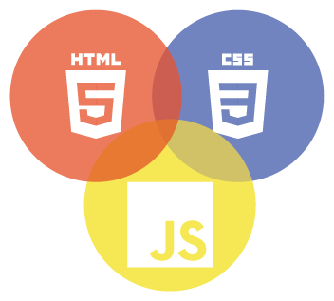
WEBPAGE DESIGNING
PRESENTATION BY :
Sourabh Gadhe 1817
Sahil Dimble 1814
Deep Marathe 1838
Devendra Chaudhari 1810
Omkar Takalkar 1863
Suraj Sankpal 1856

Slide 2
Introduction
HTML stands for Hyper Text Markup Language
HTML is the standard markup language for creating Web pages
CSS is the coding language that gives a website its look and layout. Along with HTML
CSS contains webpage elements in boxes and float those boxes to specific positions on the page
JavaScript is a programming language used primarily by Web browsers to create a dynamic and interactive experience for the user
Most of the functions and applications that make the Internet indispensable to modern life are coded in some form of Javascript

Slide 3
OBJECTIVES
To Design a Gaming Webpage by making use of HTML, JavaScript & CSS

Slide 4
Literature Survey
Sr. No. | Name Of Paper | Author | Publication Year | Description
1. | Introduction to HTML (Hyper Text Markup Language) | Ankush Sharma (Asst. Proff. Chandigarh University) | 2018 | HTML is the Standard Markup Language. It is used for developing Web Pages. HTML is Hyper Text Markup Language and is used for describing the structure of web pages.

Slide 5

To access the research paper scan QR code
or
Click on
https://www.researchgate.net/publication/327861163_Introduction_to_HTML_Hyper_Text_Markup_Language_-_A_Review_Paper

Slide 6
Project Flowchart
Game Registration
Webpage
Download Form
Error
~You must fill the data
no
Enter Data Into Text Boxes
yes
Terms & Conditions
Download

Slide 7

Result

Slide 8
Conclusion
A Gaming Webpage is created by making use of HTML & CSS codes and successfully implemented

Slide 9
THANK YOU

